Slide 1

Mini Project (KCA353) Odd Semester Session 2024-25
<< Library Management System (LMS) >>
Ritesh Kumar– 2300290140143 Pulkit Jain – 2300290140130 Ritik Vihan – 2300290140144
Project Supervisor:
Prof. (Dr.) Sangeeta Arora

Slide 2

Introducing
Library
Management
System

Slide 3

Content
Introduction (1 slide)
Literature Review (2 slides)
Objective of the Project (1 slide)
Techno
Software Requirements (Language and Platforms like Frameworks, VS code, Android Studio and Jupyter notebook etc)
Benefits (1 slide)
Gantt Chart (1 slide )
Workflow (1 slide)
References (1 slide)
Notes:
Font Styles: Times New Roman + Font Size: 25

Slide 4

INTRODUCTION
A Library Management System (LMS) is a software application designed to streamline and automate the various functions of a library.
It facilitates efficient management of books, members, and transactions, enabling librarians to easily track inventory, manage checkouts and returns, and generate reports.
Notes:
Font Styles: Times New Roman + Font Size: 25

Slide 5
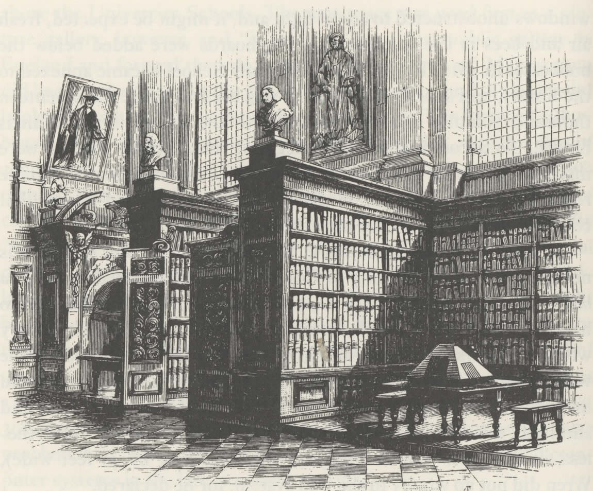
Literature Review
Early LMS systems were developed in the 1960s and 1970s, focusing on cataloging and circulation functions.
In the 1980s and 1990s, LMS systems evolved to include additional modules such as acquisitions, serials, and online public access catalogs (OPACs).
Notes:
Font Styles: Times New Roman + Font Size: 25

Slide 6
Literature Review
Modern LMS systems are web-based, offering advanced features such as discovery layers, mobile apps, and integration with other systems.
Notes:
Font Styles: Times New Roman + Font Size: 25

Slide 7
Facilitate Efficient Management: Automate and streamline library operations such as cataloging, circulation, acquisitions.
Optimize Resource Utilization : Enable librarians to effectively manage and utilize library resources, including physical materials and digital assets.
Ensure Security and Privacy: Implement robust security measures to protect sensitive information.
Notes:
Font Styles: Times New Roman + Font Size: 25

Slide 8
Technology (Hardware Requirements)
Hardware requirements:
Computer system
Storage
Printers
Backup devices
Router/Switch
Notes:
Font Styles: Times New Roman + Font Size: 25

Slide 9
Technology (Software Requirements)
Software Requirements:
Programming Languages :
Python languages used by the LMS for backend development.
Database Management System :
MySQL
User Interface Software :
Frontend technologies such as HTML, CSS, JavaScript and bootstrap.
Notes:
Font Styles: Times New Roman + Font Size: 25

Slide 10
Modules
Book Cataloging: Add, edit, and delete book records, including title, author, publisher, publication date, and ISBN.
Book Searching: Search for books by title, author, subject, or keyword.
Book Availability: Check the availability of books and update the status (available, borrowed, lost, or damaged).

Slide 11
Modules
Book Borrowing: Allow patrons to borrow books, including setting due dates and tracking borrowing history.
Book Returning: Process book returns, including updating the book's availability and patron's borrowing history.
Fine Management: Calculate and manage fines for overdue books

Slide 12
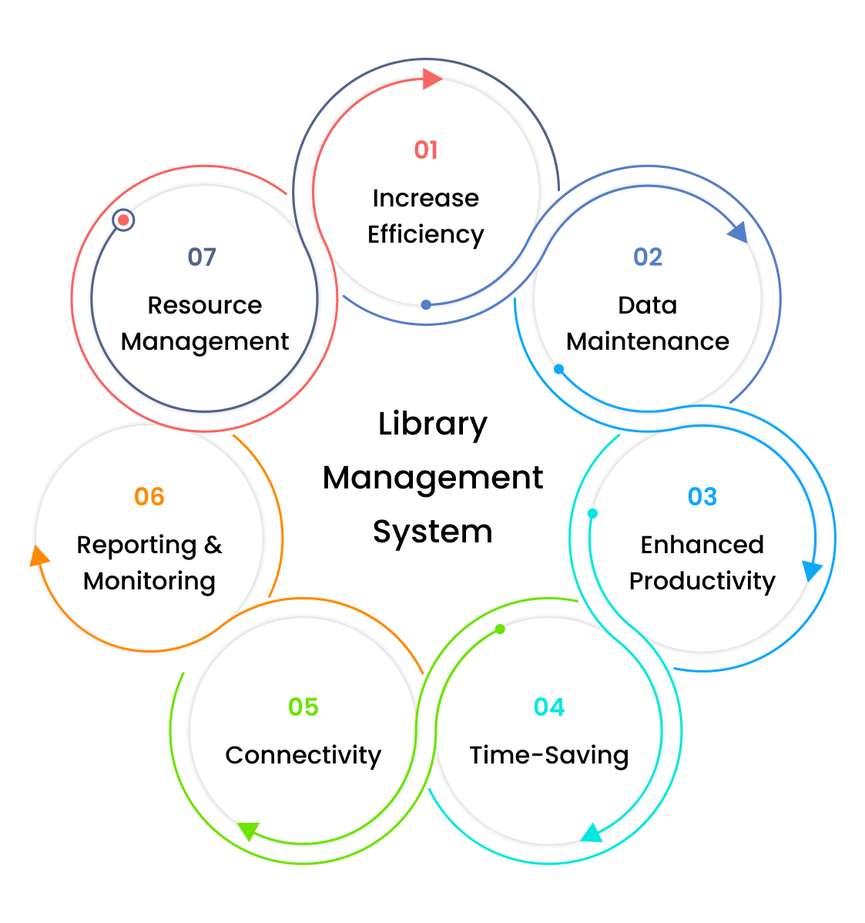

Notes:
Font Styles: Times New Roman + Font Size: 25

Slide 13
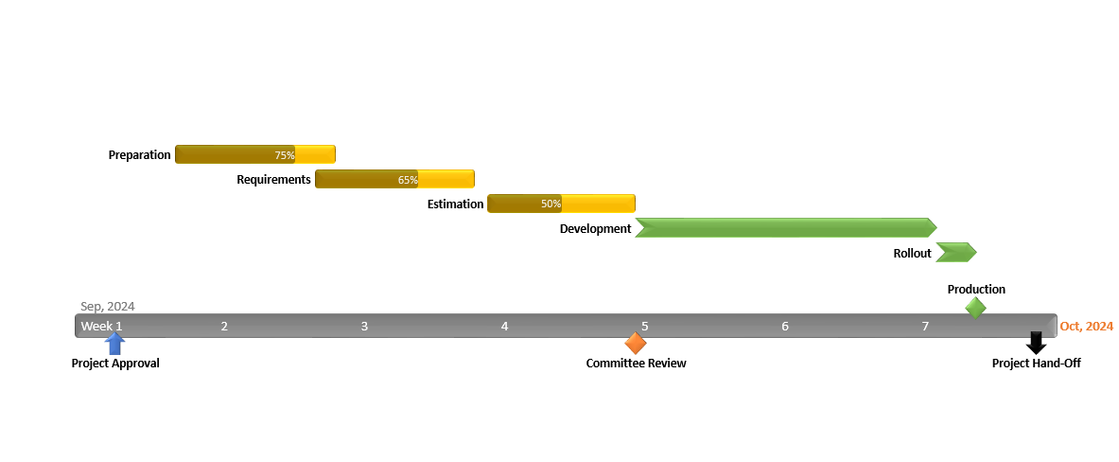
Gantt Chart
Notes:
Font Styles: Times New Roman + Font Size: 25

Slide 14
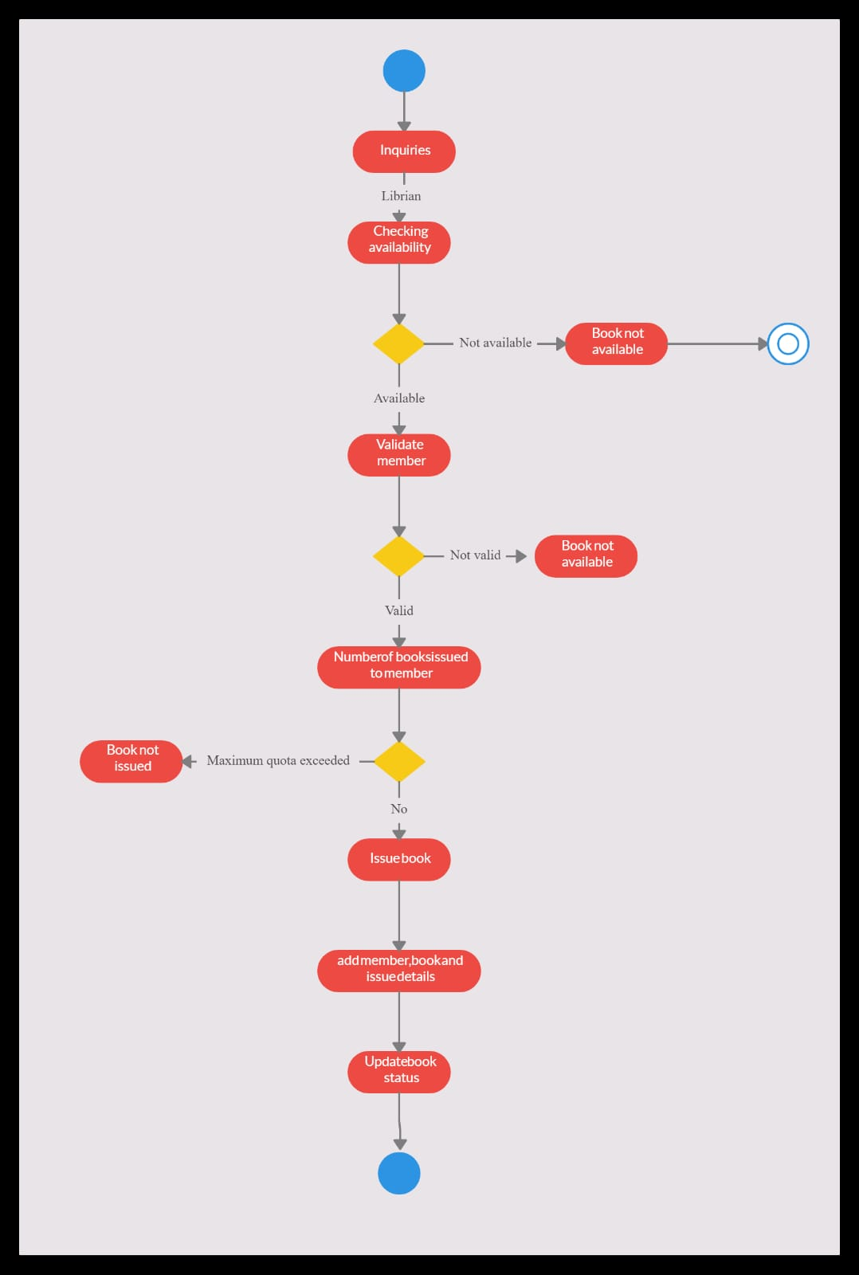

Workflow

Slide 15

Reports
Borrowing Report: Displays a borrowing history, including the number of books borrowed, returned, and renewed.
Fines Report: Displays the total fines owed by patrons, helping librarians track and manage outstanding payments.
Daily Circulation Report: Displays the number of books borrowed, returned, and renewed on a daily basis.
Monthly Circulation Report: Provides a monthly summary of book circulation, including the number of books borrowed, returned, and renewed.

Slide 16
References
Xie, H., & Zhang, X. (2012). Library Management Systems and Digital Libraries: A Conceptual Perspective. Journal of Library Administration, 52(3), 257-275.
Bibliotecha. (2016). Open Source Library Management Systems. Retrieved from [https://bibliotecha.com/open-source-library-management-systems](https://bibliotecha.com/open-source-library-management-systems).
Biswas, P. (2019). Emerging Trends in Library Management Systems: A Review. DESIDOC Journal of Library & Information Technology, 39(4), 207-213.
Towey, D. (2018). Data Security and Privacy Concerns in Library Management Systems. Journal of Library Administration, 58(2), 163-176.

Slide 17

Thank
You

